Slide 1
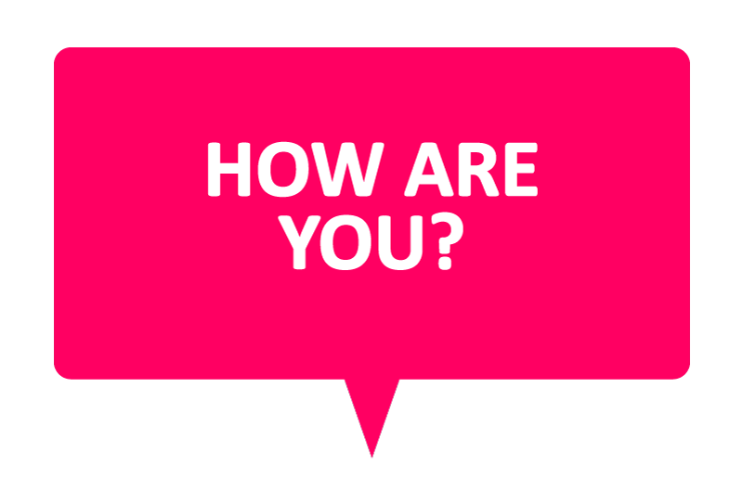
WELCOME TO ENGLISH CLASS

Slide 2
WELCOME TO ENGLISH CLASS
“Make your life a masterpiece; imagine no limitations on what you can be, have or do."
- Brian Tracy

Slide 3

ALGORITHMS

Slide 4

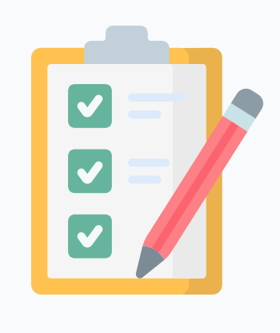

DATE
DATE
Objective:
Students will demonstrate their understanding of the topic Algorithms with a graphic organizer.

Slide 5

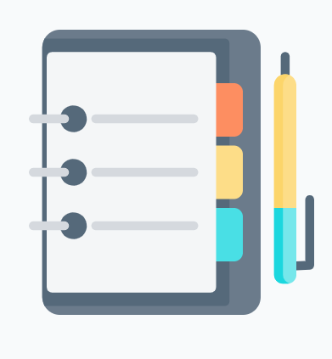


AGENDA
WARM UP:
Acrostic to introduce the main topic
CLASS ACTIVITY:
Let’s share the Vocabulary
Match the questions with the correct and logical answer.
Reading Strategy
Read the text : Algorithms
Wrap- Up
Answer these True/False questions about the text.

Slide 6
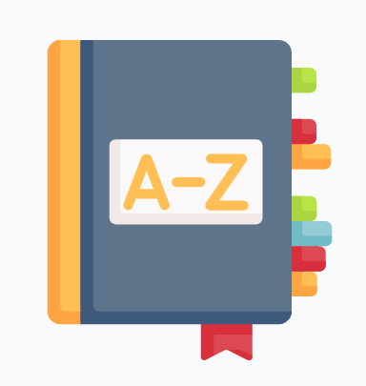
VOCABULARY
Programmers: programador
Broad : Amplio
Far-reaching :Amplio de añlcalze
File
Share
Layout: plano
Focial networks: redes sociales
Features: caracteristica
Proficient . competente
Unlock . desbloquiar

Slide 7
VOCABULARY
WORD | Definition | synonym | Picture
Programmers | People who writes computer programs. | Computer specialist
Broad | Covering a large number and wide scope of subjects. Cubriendo un gran número y una amplia gama de temas. | Extensive
Far- reaching | Having an extensive influence Tener una amplia influencia | Wide- ranging
File | A folder or box for holding loose papers together and in order for easy reference. | Binder
Share | Have a portion of (something) with another or others. | Divide
Layout | The way in which the parts of something are arranged or laid out. Forma en que se disponen o disponen las partes de algo. | structure

Slide 8
VOCABULARY
Social networks | a dedicated website or other application which enables users to communicate with each other by posting information, comments, messages, images, etc. | social media
Features | a distinctive attribute or aspect of something. | characteristic
Proficient | competent or skilled in doing or using something. | Expert
Unlock | undo the lock of (something), typically with a key. deshacer la cerradura de (algo), normalmente con una llave | open

Slide 9
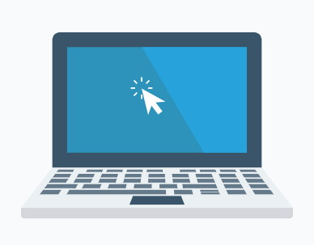
Match these questions with the correct and logical answers
Questions:
What are some examples of social networks?
What are some examples of a cell phone features?
What are you proficient in?
How do you unlock your cellphone?
What are the broad terms for these groups of words?
Example: rose, orchid, lily => flowers
apple, orange, banana =>
dog, cat, hamster =>
cell phone, computer, tablet =>
6. What file types do you know?

Slide 10
Answers (in the correct order)
Facebook, Instagram, TikTok.
Make calls, send messages, listen to music, calculator.
I am very good at mathematics and physics.
I have a password and I use my fingerprint.
Answers:
Fruits
Animals
Devices. aparato
PPT, Excel, Word.
No, because I like to keep my things private.
Answers:
Both
In the office
Computers (or other devices)
It is different because the positions of some symbols is not the same.

Slide 11
Video Reading Strategy: Using graphic organizers
https://youtu.be/uU0v8eFO53g

Slide 12
Text Algorithms
Algorithms: a common language for nature, human, and computer. ” — Avi Wigderson
What is an algorithm? Algorithm can be defined as a method for solving a problem. Some people think that it is something new, but the study of algorithms dates at least to Euclid – 300 BC! It was formalized by Church and Alan Turing in 1930s and developed more in the 20th century. It is interesting that some important algorithms were discovered by university students and not by expert programmers!
The impact of algorithms is broad and far-reaching. First, the Internet is full of them, for example, the web search, packet routing, and distributed file sharing. Second, the world of biology also works with algorithms: think of human genome project and protein folding. In the 20th century, algorithms contributed to the development of computers with the circuit layout, file system, compilers and many other things.

Slide 13
Text Algorithms
Consequently, computer graphics appeared and introduced movies, video games and virtual reality in our lives. In the 21st century, algorithms have been used for different social networks features like recommendations, news feeds, advertisements, and so on. Did you know that voting machines also use algorithms to count the votes in elections? So they are even used in politics!
So why should we study algorithms? They can help us solve problems that cannot have other solutions. If you want to stimulate your intellect and become a proficient programmer, it is also a good idea to study algorithms. Additionally, they may unlock the secrets of life and of the universe. Finally, computational models are replacing math models in scientific inquiry and will become more and more important in the future.
Adapted from: Coursera, Algorithms Part I

Slide 14
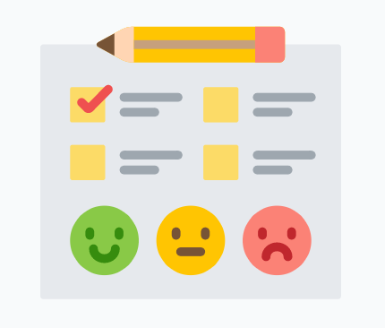
WRAP-UP
Answer these True/False questions about the text.
The study of algorithms appeared in the 20th century.
Algorithms are only used in programming.
University students can discover algorithms.
Recommendations on social networks are results of algorithms.
Math models are more important today that computational models.

Slide 15
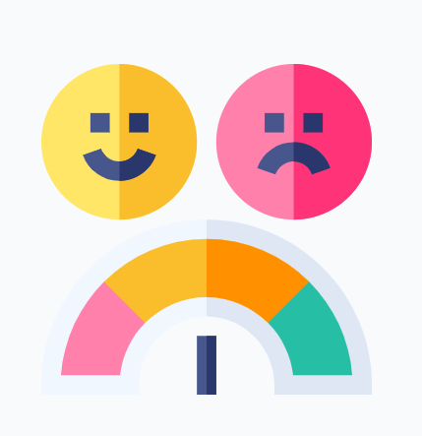
SELF-EVALUATION
Answer the questions.
Los organizadores gráficos me ayudan a organizar la información que leo. Si ☺ No ☹ De pronto :|
Los organizadores gráficos me ayudan a visualizar la información que leo. Si ☺ No ☹ De pronto :|
Entiendo que son los algoritmos y cómo se usan. Si ☺ No ☹ De pronto :|

